Slide 1
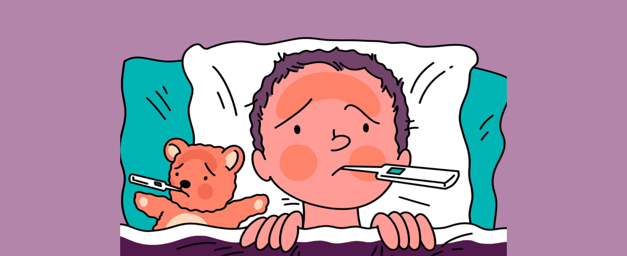
Fever Associations
By Dr/ Amr Ahmed Hamed
Lecturer of Tropical Medicine and Gastroenterology
Faculty of Medicine Sohag University

Slide 2
Agenda
Fever with sweating
Fever with jaundice
Fever with rigors
Fever with hepatomegaly
Fever with relative bradycardia
Fever with splenomegaly
Fever with rash
Fever with lymphadenopathy

Slide 3
Fever with sweating
Infectious causes:
Brucellosis may be liters / day .
Tuberculosis.
Malaria.
Toxemia, septicemia, puerperal sepsis, and closed abscesses.
B. Non-infectious causes:
Hodgkin’s lymphoma (Pel-Ebstein fever).
Rheumatic fever.

Slide 4
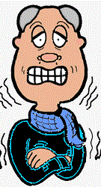

Slide 5
Fever with rigors
Rigors (i.e., bed-shaking chills) indicate sudden onset of fever
Rigors often mark the onset of bacterial infection, typically bacteremia, although they may occur in other clinical situations

Slide 6
Fever with rigors
A. infectious causes:
1. Bacterial:
Acute pyelonephritis.
Lobar pneumonia
Meningitis
Cholangitis
Acute bacterial endocarditis.
Pyogenic abscess (rigors are repeated).

Slide 7
Fever with rigors
2. Viral:
COVID-19
Influenza
3. Parasitic:
Malaria (rigors are repeated (with release of merozoites from R.B.Cs)
Amoebic hepatitis
B. Non-infectious causes:
Drug-induced fever
Transfusion reaction
Heat stroke

Slide 8
Fever with relative bradycardia
Relative bradycardia is defined as pulse temperature dissociation.
Every rise in temperature by 1° C is usually accompanied by increased heart rate by 10 beats/minute
In some fevers, this relation is not kept, and pulse is relatively slow.

Slide 9
Fever with relative bradycardia
A. infectious causes:
1. Bacterial:
Typhoid fever
Leptospirosis
2. Rickettsial: Q-fever
3. Viral: viral hemorrhagic fevers (yellow fever, dengue).

Slide 10
Fever with relative bradycardia
4. Parasitic:
Malaria
Chagas disease
B. Non-infectious causes:
Lymphoma.
Drug induced fever.
Factitious fever.

Slide 11
Fever with rash
A. Infectious causes:
1. Bacterial:
Bacterial Meningitis
Scarlet fever
Enteric fever (rose spots: uncommon finding(
2. Rickettsial: typhus and rickettsioses

Slide 12
Fever with rash
3. Viral:
Viral hemorrhagic fever
Acute HIV infection
Measles
Varicella-zoster virus infection (chickenpox or herpes zoster )
Infectious mononucleosis
4. Parasitic: acute schistosomiasis

Slide 13
Fever with rash
B. Non-infectious causes:
Blood diseases as purpura
Drug induced fever
C. Skin diseases: e.g., impetigo, infected eczema, syphilis, etc.

Slide 14
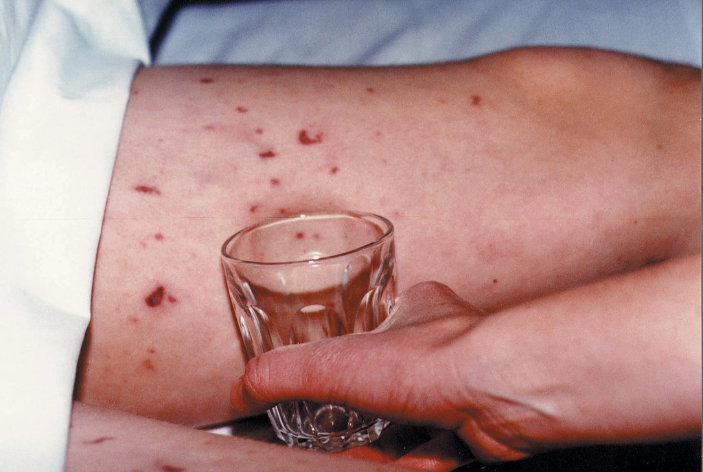
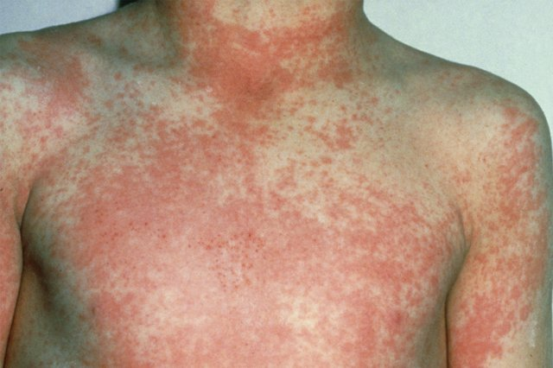
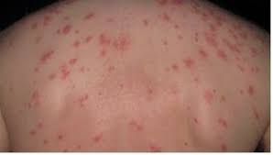
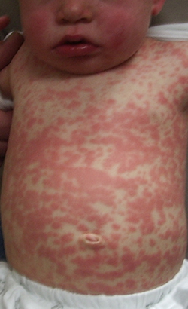
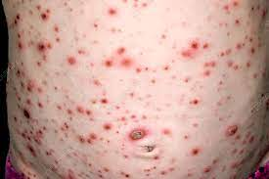
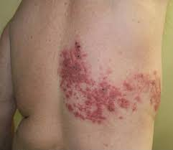
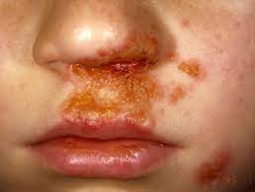
Meningococcal septicemia (glass test)
Scarlet fever rash (sandpaper like skin)
Rose spots (typhoid fever)
Heroes zoster rash
Impetigo
Chickenpox rash
Measles rash

Slide 15
Fever with jaundice
A. Hepatocellular jaundice:
1. Viral infections:
Acute viral hepatitis
Yellow fever
Infectious mononucleosis
2. Bacterial infections:
Leptospirosis
Septicemias
3. Parasitic infections: Amoebic hepatitis
4. Liver cirrhosis with liver cell failure

Slide 16
Fever with jaundice
2. Cholestatic jaundice:
Cholangitis
3. Hemolytic jaundice:
Malaria (Black water fever)
Sickle cell crisis with infective trigger.

Slide 17
Fever with hepatomegaly
A. Tender liver:
Acute viral hepatitis
Amoebic hepatitis
Pyogenic liver abscess
Leptospirosis (Weil's disease)
Liver metastasis

Slide 18
Fever with hepatomegaly
B. Non-tender liver:
Bacterial infections: Tuberculosis, Typhoid fever, brucellosis
Viral infections: infectious mononucleosis
Parasitic infections: malaria, Kala azar, acute bilharziasis (Katayama fever)
Blood diseases: lymphoma, leukemias

Slide 19
Fever with splenomegaly
A. Infectious causes:
1. Bacterial :
Typhoid fever
Brucellosis
Tuberculosis
Subacute bacterial endocarditis
Septicaemia
Splenic abscess

Slide 20
Fever with splenomegaly
2. Viral:
Infectious mononucleosis
Cytomegalovirus infection
3. Parasitic:
Malaria
Toxoplasmosis
Kala-azar
African trypanosomiasis (Sleeping sickness)
Acute stage of American trypanosomiasis.

Slide 21
Fever with splenomegaly
B. Non-infectious causes:
1. Blood diseases: Leukaemia, lymphoma
2. Collagen diseases: Systemic lupus erythematosus(SLE), Still's disease, Felty's syndrome
3. Others : Ulcerative colitis

Slide 22
Fever with lymphadenopathy
A. Infectious causes:
1. Bacterial:
Tuberculosis (cervical adenitis)
Brucellosis
Pyogenic lymphadenitis (draining a septic focus)
Diphtheria
Plague

Slide 23
Fever with lymphadenopathy
2. Viral:
Infectious mononucleosis (triad of fever, tonsillar pharyngitis, and lymphadenopathy).
Acute HIV (fever, generalized lymphadenopathy, sore throat, rash)

Slide 24
Fever with lymphadenopathy
3. Parasitic:
Toxoplasmosis
African trypanosomiasis (Winterbottom sign)
Acute stage of American trypanosomiasis.
Acute bilharziasis (Katayama fever)
B.Non-infectious:
Blood Diseases: Acute leukemias, chronic lymphcytic leukemia,
Hodgkin's disease
Cholagen disease: SLE, Still's disease, Felty's syndrome
Metastatic malignancies

